Slide 1
Tutoring by Appointment:
Small Group Tutoring
mlc.tamu.edu

Slide 2
Follow Step 1 of the instructions and click on the course Tutoring by Appointment button. You will be required to sign in through the Navigate Portal to continue with booking your appointment. You must be enrolled in the designated course to schedule an appointment.

Slide 3
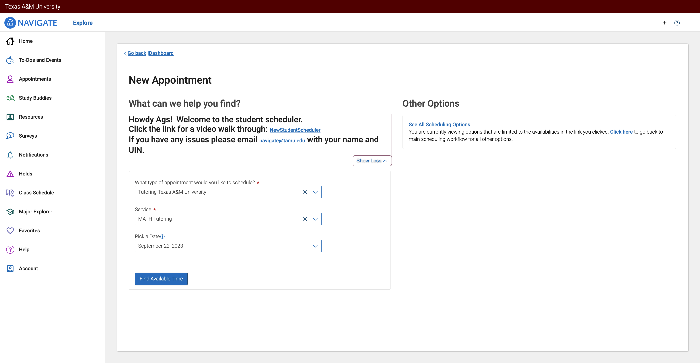
The following page will appear once you have clicked on the button to schedule your tutoring by appointment session and signed in. Click on Find Available Time.

Slide 4
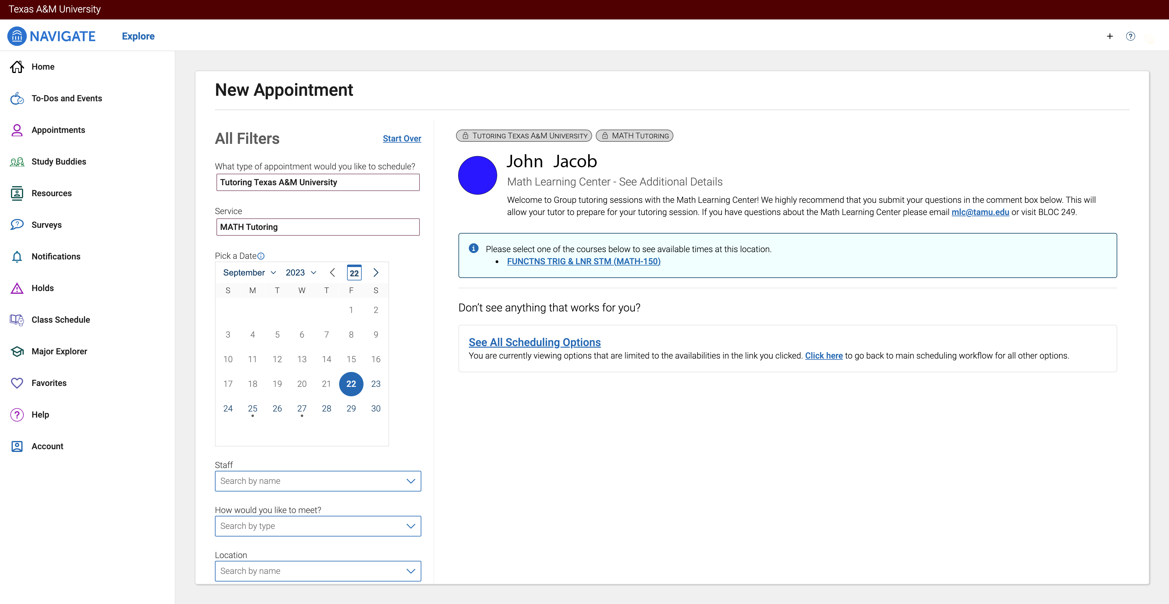
The next page will have information about your tutor and the courses that you can search for available tutoring times.
On the calendar, there are dates that have dots underneath them. Those dates show when the tutor is available for small group tutoring.
Select the course you are looking to schedule a tutoring session.

Slide 5
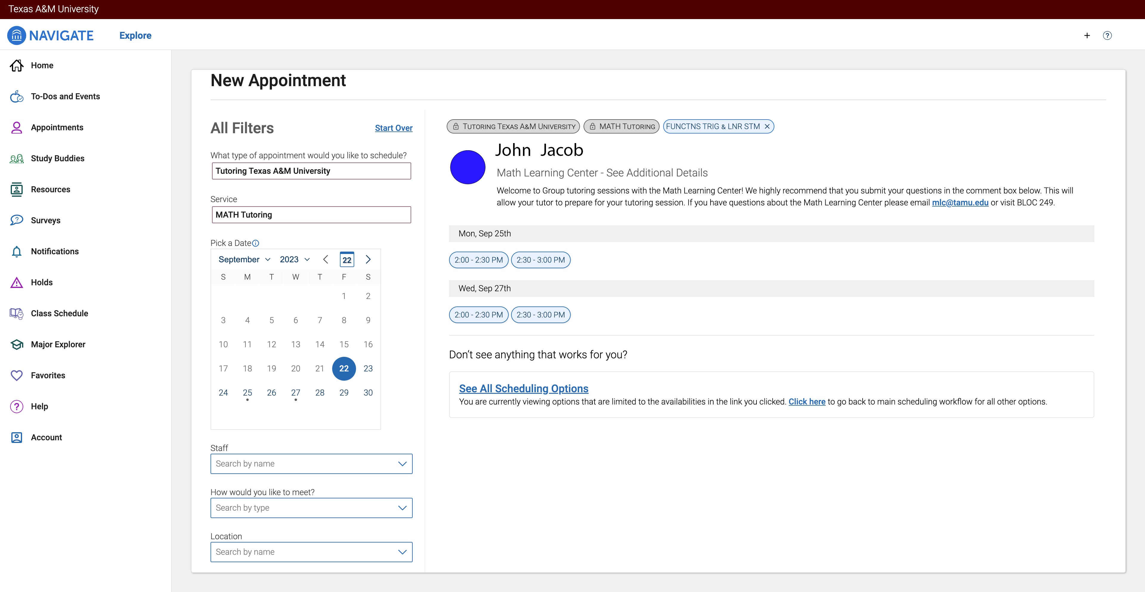
Select the date and time that works best for your schedule.

Slide 6
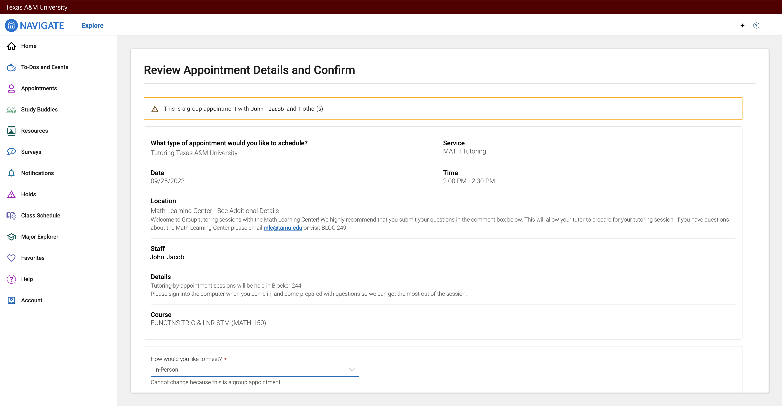
A review appointment details screen will show up. It will include the date, time, and name of your tutor. The location of your appointment can be found in the details section.
The next slide is the same page after you scroll down.

Slide 7
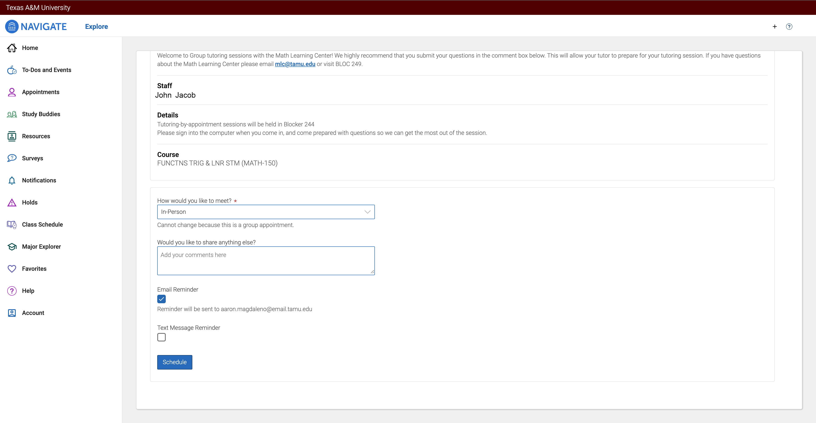
Once you scroll down, there will be a comment box to share anything else. Please use this box to let the tutor know what you would like to cover during the tutoring session.
Make sure that Email Reminder has a check box so that a reminder email is sent to your @tamu.edu email.
Make sure that you click on schedule to confirm your appointment! Your appointment will not be scheduled if you do not complete this step.
student@tamu.edu

Slide 8
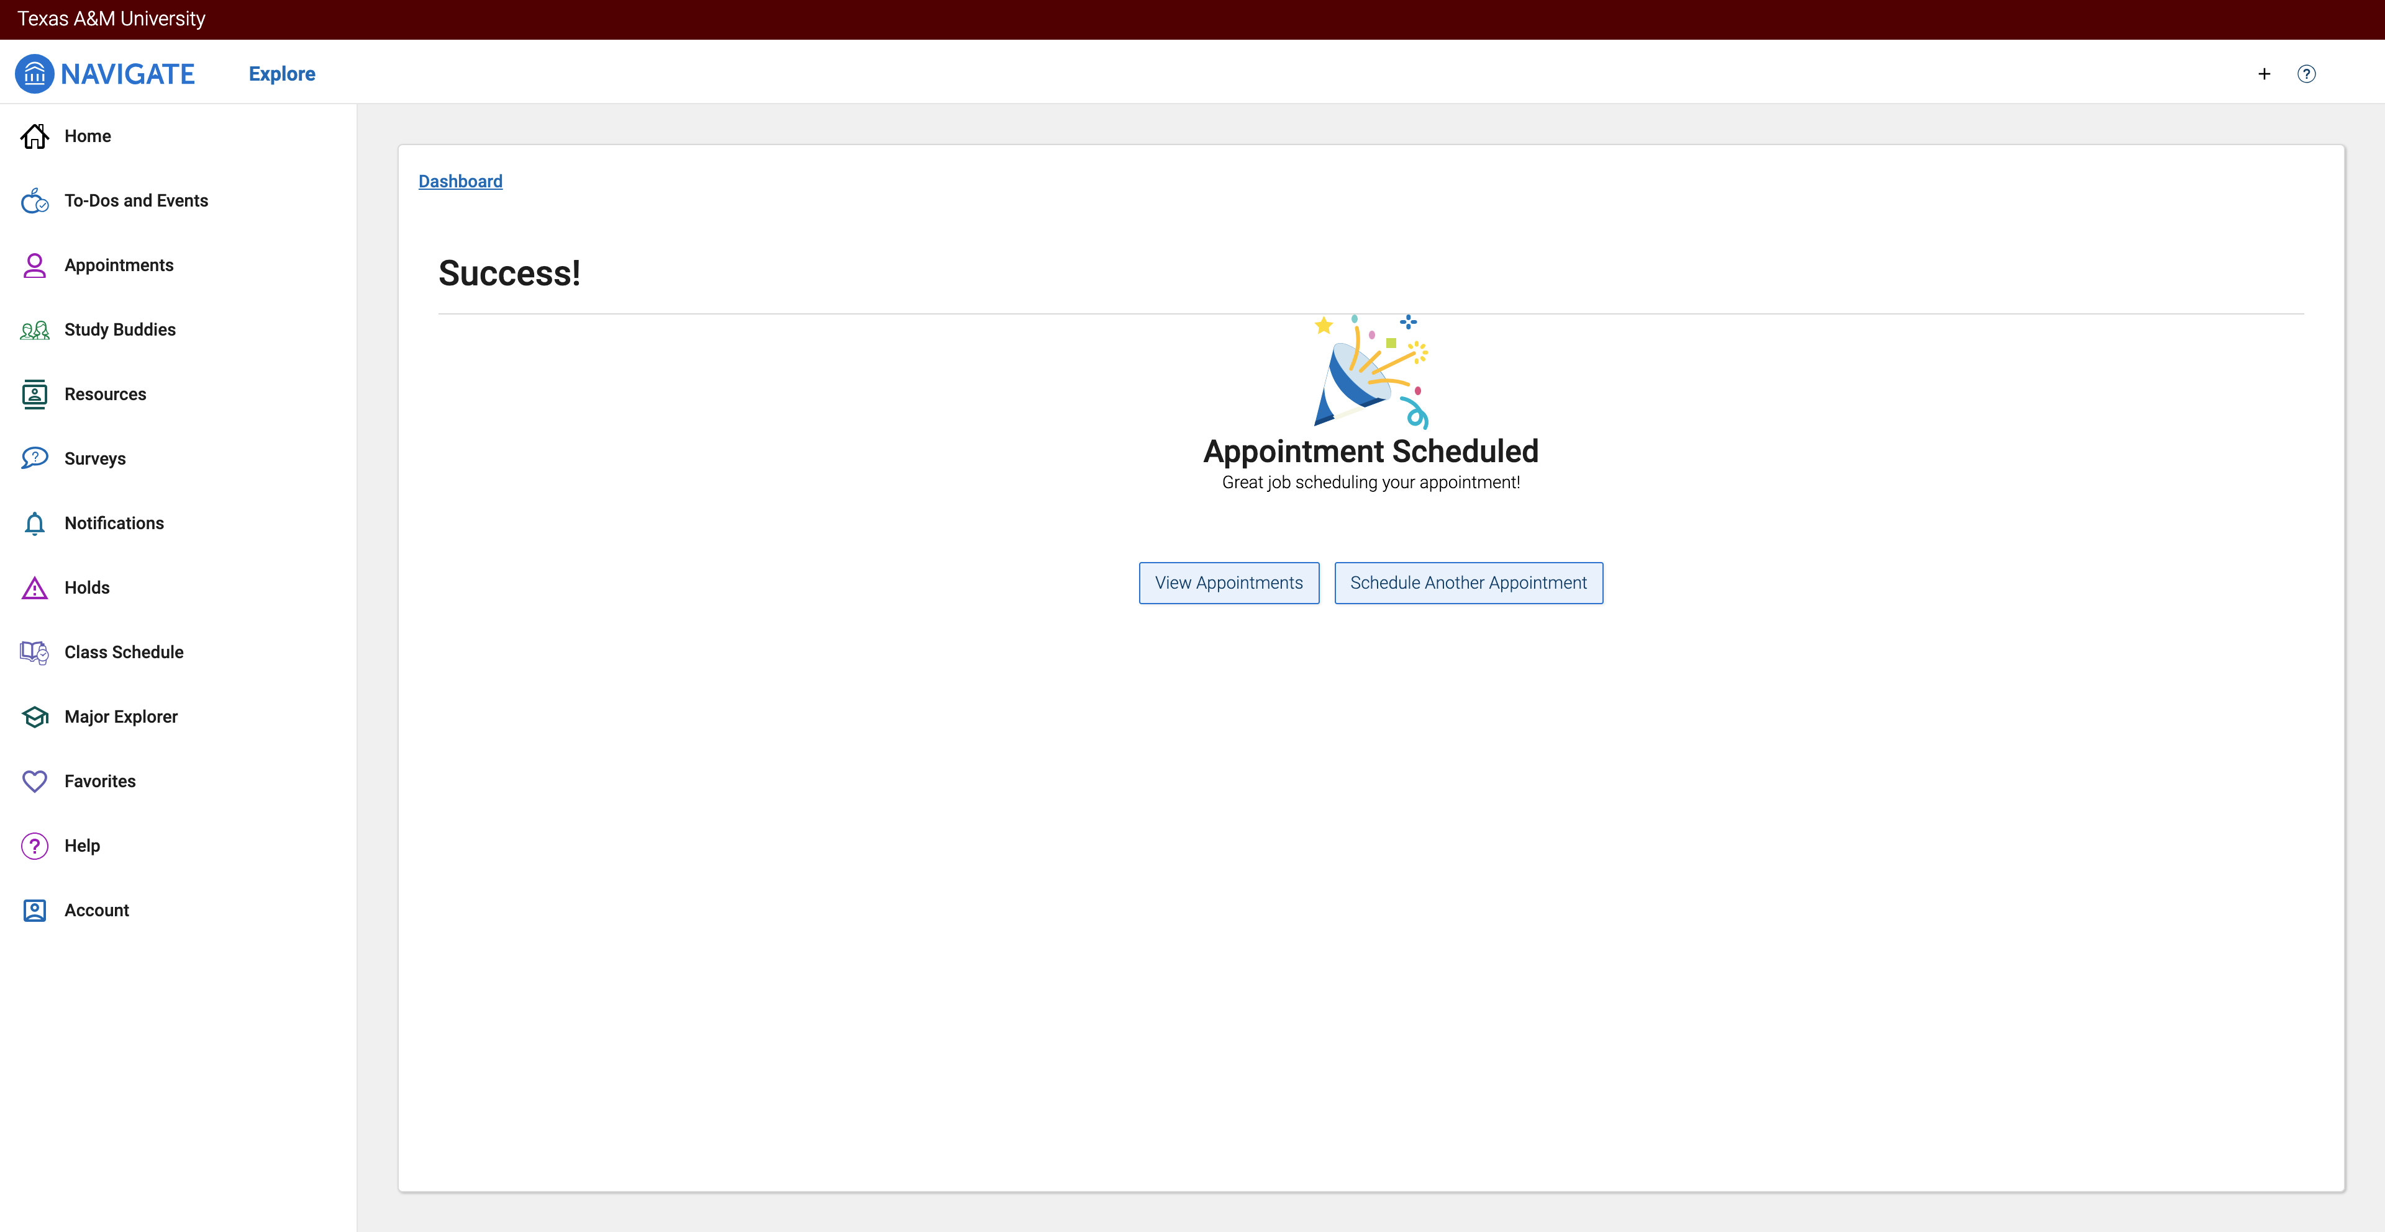
This screen will verify that your appointment has been scheduled.

Slide 9
Thank you!

